Slide 1


Barbara C. Farhar, Ph.D.
Principal Investigator
Dragan Maksimovic, Ph.D.
Co-Principal Investigator
Alison Peters,
Senior Manager
Preliminary Findings
The Human Dimensions of
Plug-In Hybrid Electric Vehicles in Boulder
Future Mobility Seminar Presentation
16 October 2012

Slide 2
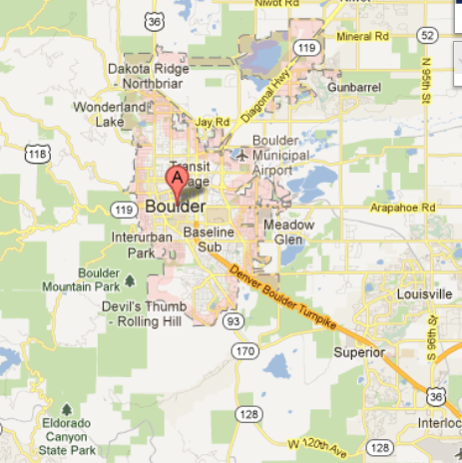
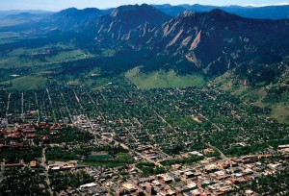
Outline of Presentation
Barbara C. Farhar, Ph.D.
  Part One: Introduction, research design, interest in PHV purchase, feedback, and charging behavior
    Part Two: Vehicle and smart-plug data
    Part Three: Ongoing analysis and preliminary conclusions

Slide 3



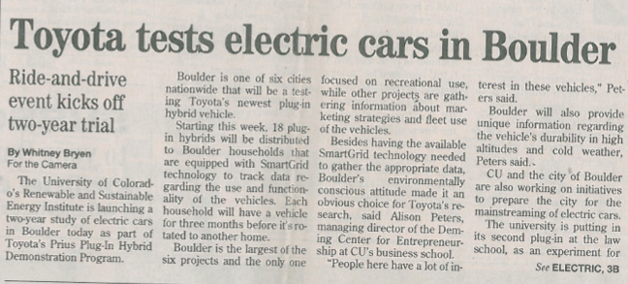
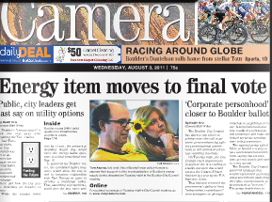

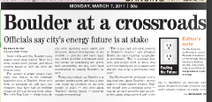
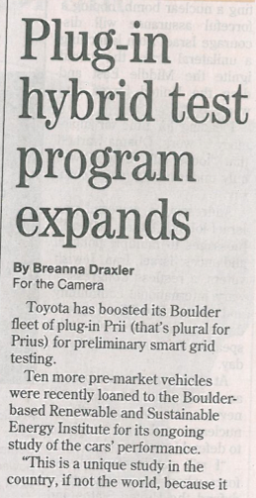
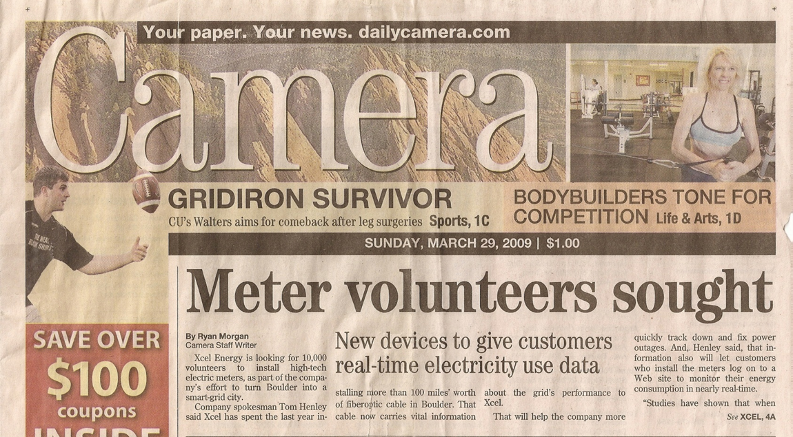
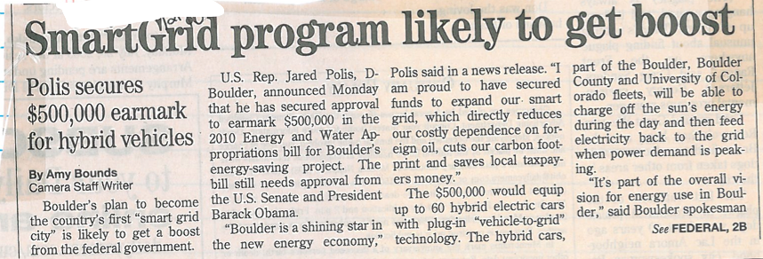
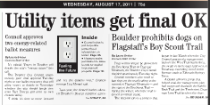
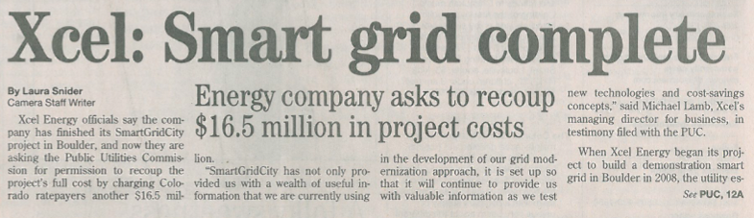
Community Context

Slide 4
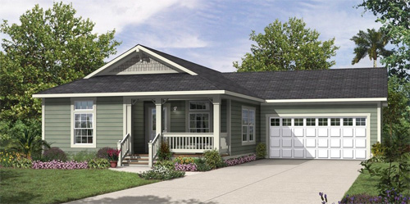
Introduction to the Research
Toyota sponsored the research at CU
Xcel Energy was a study partner
Purposes of the research
Household selection process
Charging and gasoline cost estimates provided
Household requirements
All family members over 21 participated
Household is an economic unit
Safe driving records
Usable garage with outlet
Wireless internet capability
Smart meters already installed

Slide 5
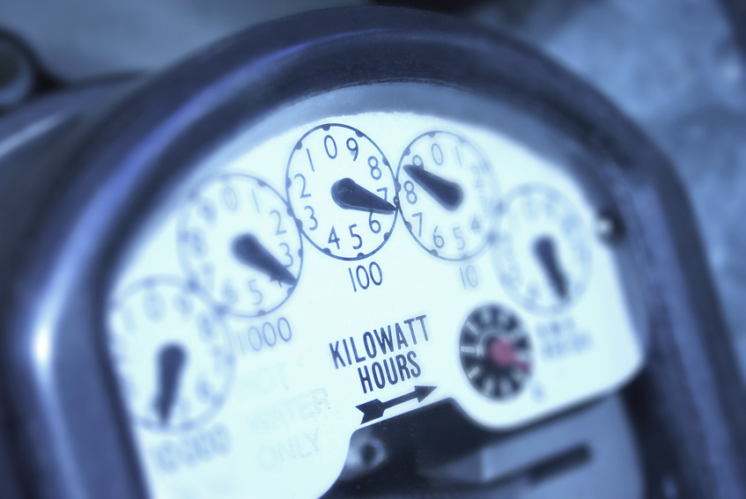
Sampling Matrix and Rate Structure
Methods
 | Standard pricing | Time-of-use pricing | Total n
Unmanaged charging | 31 | 40 | 71
Managed charging | 34 | 37 | 71
Total n | 65 | 77 | 142
Rate Structure | $/kWh*
Standard
Winter (all kWh) and summer (0-500 kWh/month) | 0.096
Summer (500+ kWh/month) | 0.14
Time-of-use
Summer on-peak | 0.232
Winter on-peak | 0.11
Year round off-peak | 0.089
Peak: 2 pm to 8 pm
Off-peak: 8 pm to 2 pm
Summer: June 1 through September 30
Winter: October 1 through May 31
*Rates include all “riders” and adjustments by the utility equaling approximately $0.05/kWh

Slide 6
Data Collection
Methods
Data sources:
284 face-to-face two-hour qualitative family interviews (pre- and post-)
512 driver questionnaires administered in-person (pre- and post-)
142 sets of open-ended online diaries
142 sets of smart plug data in 5-minute increments for 9 weeks
142 sets of 18-month household electricity data in 15-minute increments
142 sets of monthly utility bills for 18 months
102 sets of data-logger data from the Boulder PHVs
Events
Week 1
Initial contact
Weeks 2-3
Informed consent meeting
Week 3
DMV check
Week 4
Smart plug installation/
training and vehicle pickup
Week 13
Vehicle return
Month 1
Month 2
Month 3
Month 4
collection
Weeks 2-3
Pre-interview/ questionnaire
Weeks 4-13
Weekly online diary entries
Weeks 13-14
Post-interview/ questionnaire
Data

Slide 7
Selected Sample Descriptors
Number of households: 142
Number of drivers: 265 (129 female, 136 male)
Households that currently own Toyota vehicles: 60 (42%)
Households that own hybrid vehicles: 32 (23%)
 | Range | Mean
Vehicles owned | 1 – 5 | 2.25
Miles driven/year | 1,500 – 50,000 miles | 16,628 miles*
Miles/gallon (primary vehicle) | 12 – 51 | 25.5
*National average = 12,000 to 15,000 miles per annum

Slide 8
Selected Demographics
Age (21 to 89) | %
Under 25 | 1
25 to 40 | 21
41 to 60 | 51
Over 60 | 27
Education | %
Less than 4 years of college | 6
4-year college degree | 37
Advanced degree | 57
Household income | %
Less than $100,000 | 25
$100,000 to $150,000 | 36
Greater than $150,000 | 38
Total | 99*
Political views | %
Very liberal/liberal | 72
Neither | 19
Very conservative/ conservative | 9
Pre-questionnaire (n = 265 drivers)
*Does not add to 100 due to rounding

Slide 9
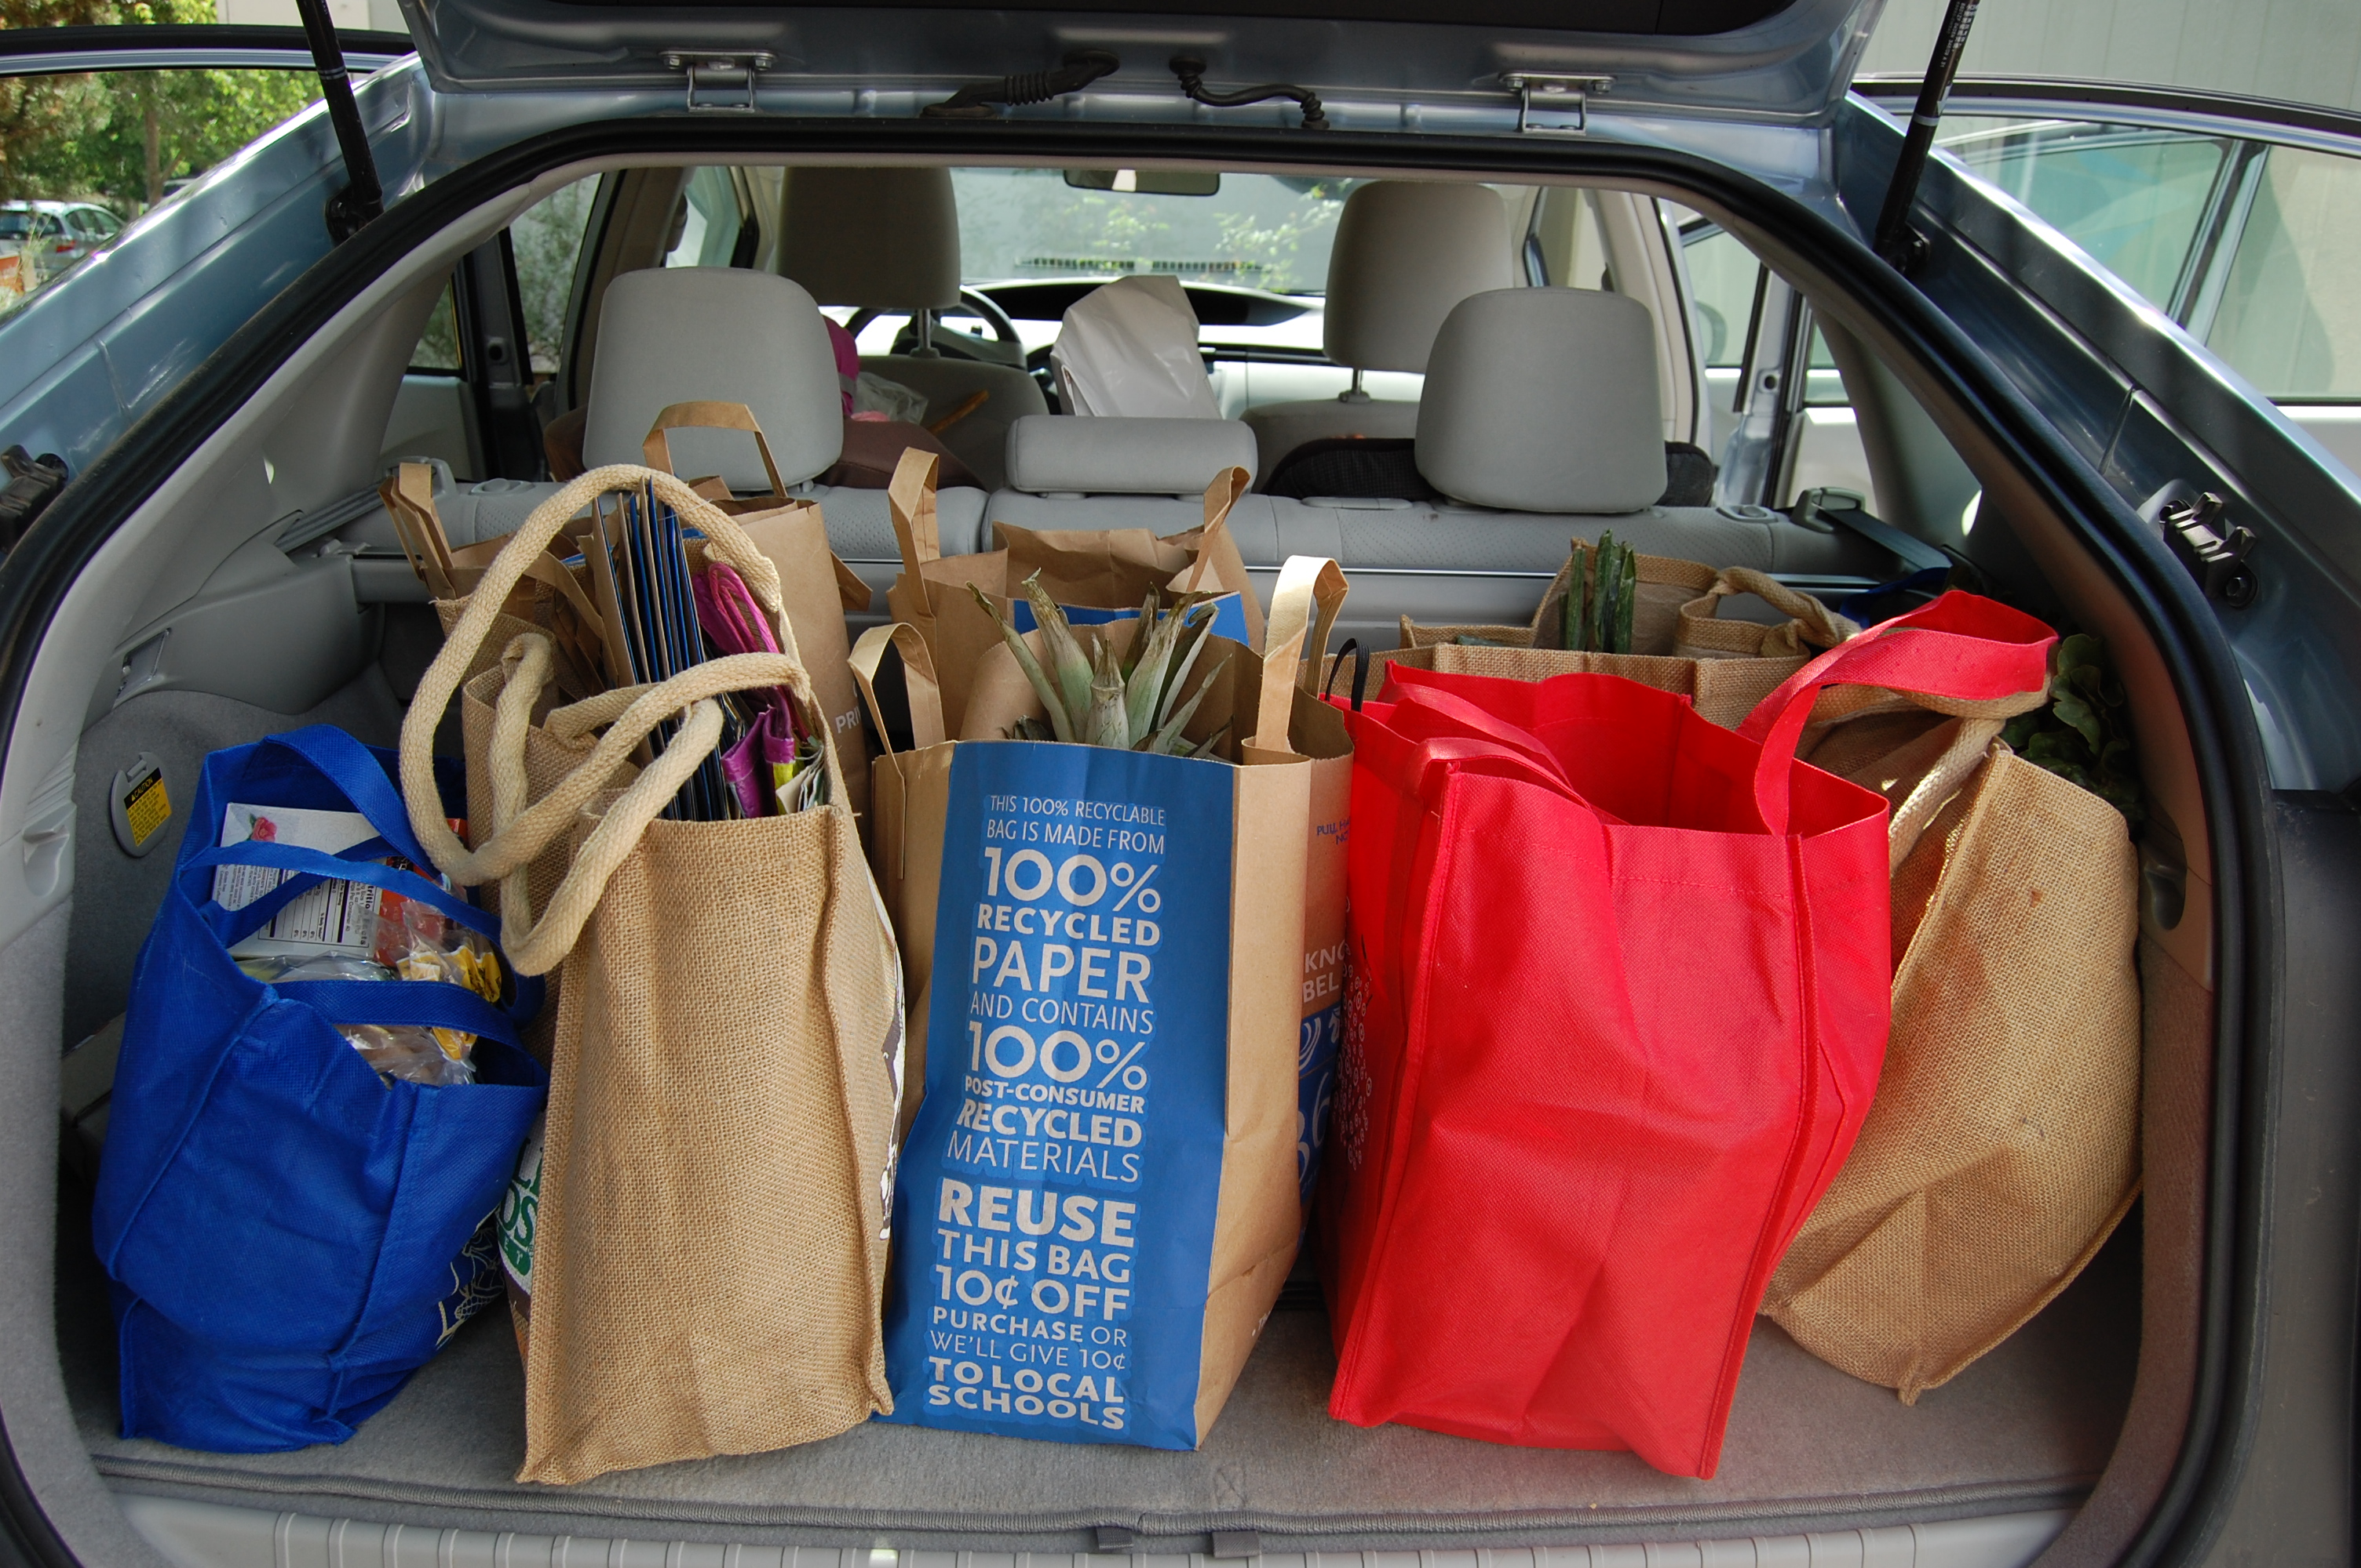
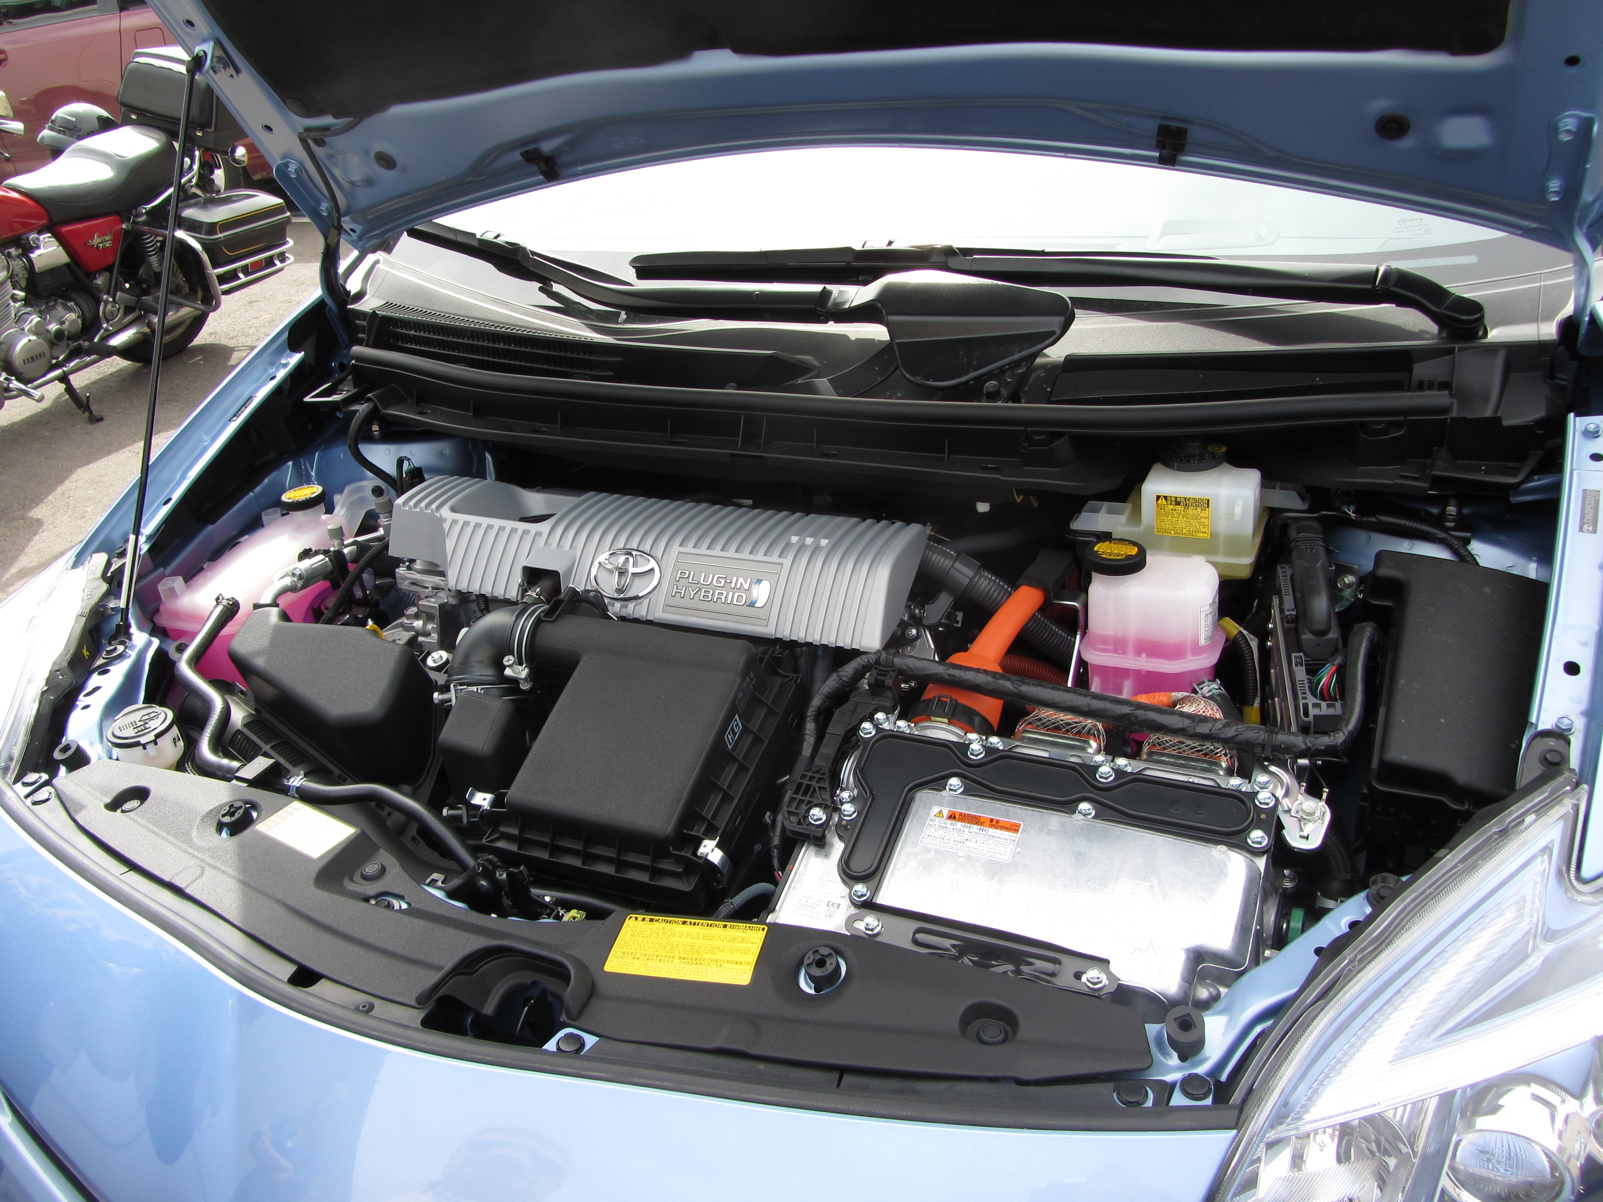
Reasons for Participating in the Study
Why are you interested in being part of the PHV field test?
(open-ended question)
Response | % of all responses
Practical | 33
Altruistic | 27
Technological | 22
Personal enjoyment | 14
Voluntary simplicity/localization | 4
Total | 100
Pre-interview (n = 142 households with 328 total volunteered responses)

Slide 10
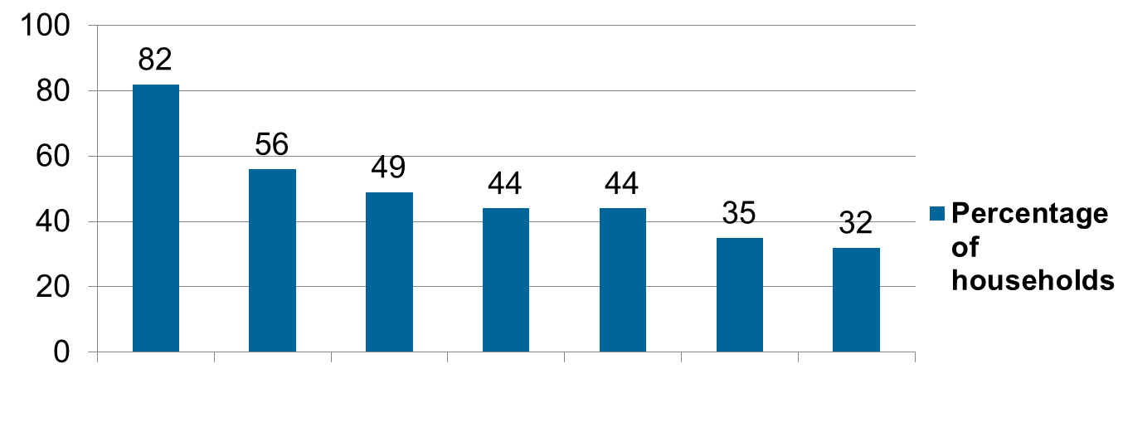
Top Car Likes
open-ended question
Quiet
Dashboard
feedback is useful
Easy to plug in
Get-up-and-go!
Handling/driving
performance
Spacious inside
Saving money
on gas
753 total volunteered responses to car likes
Post-interview (n=142 households)

Slide 11
Symbolic Meaning of the Car
Percent of
all households
77
What kind of statement do you think the car makes?
Environmentally conscious
23
Technologically cutting edge
20
Trendsetter, early adopter
13
Saving money, efficient
12
Proud, smug, status symbol
11
Responsible, virtuous, helping society
11
Hip, cool, very Boulder
6
Affluent, yuppie
Unmanly
5
Nerdy
4
Slow driver, old, conservative
4
3
Flashy, pretentious
Post-interview (n = 142 households)
2
Not environmentally conscious

Slide 12
Interest in PHV Purchase and EV Range
12
Would you consider buying a PHV?
What would be the ideal EV range (miles) for the PHV?
Response | %
Yes | 71
No | 29
Total | 100
How satisfied are you with the EV range of 14 miles?
100+
13%
14-20
16%
51-99
12%
Response | %
Very satisfied | 8
Somewhat satisfied | 39
Somewhat dissatisfied | 33
Not at all satisfied | 20
Total | 100
21-30
29%
41-50
18%
31-40
15%
Post-questionnaire (n = 264 drivers)
Post-interview (n = 142 households)

Slide 13
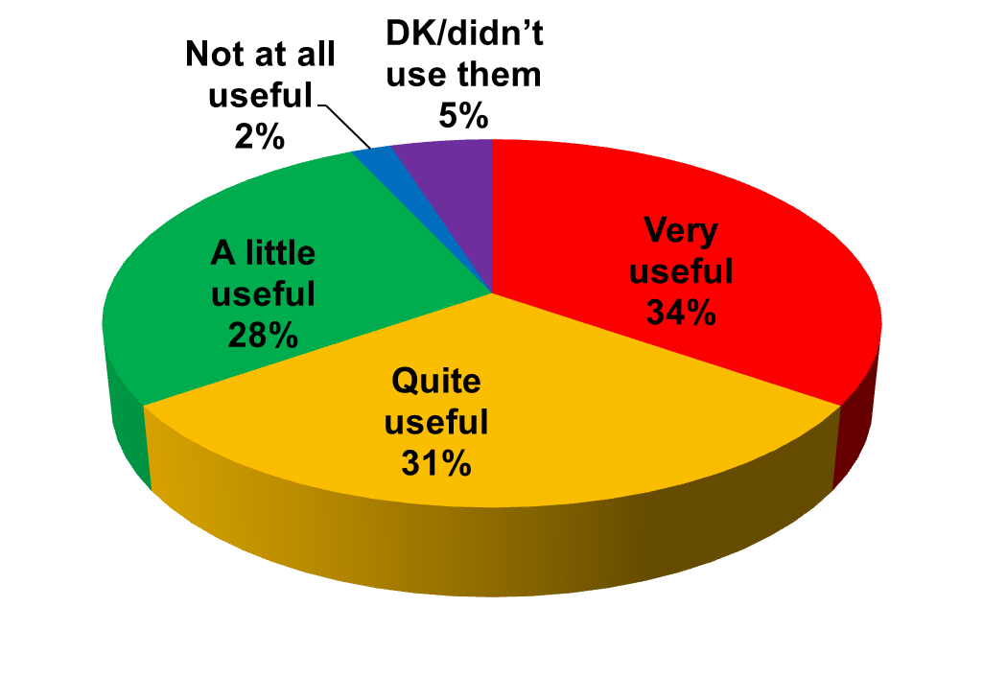
Dashboard Feedback
How useful were the feedback displays in the car?
Did you sometimes drive in a
way to optimize fuel economy?
Response | %
Almost always | 28
Most of the time | 31
Some of the time | 23
Hardly ever | 8
Never | 10
Total | 100
Post-questionnaire (n=261 drivers)

Slide 14
Smart-Meter Feedback
How often are you looking at the feedback on your household electricity consumption from the smart meter? (Pre)
Pre-interview (n = 80 households)

Slide 15
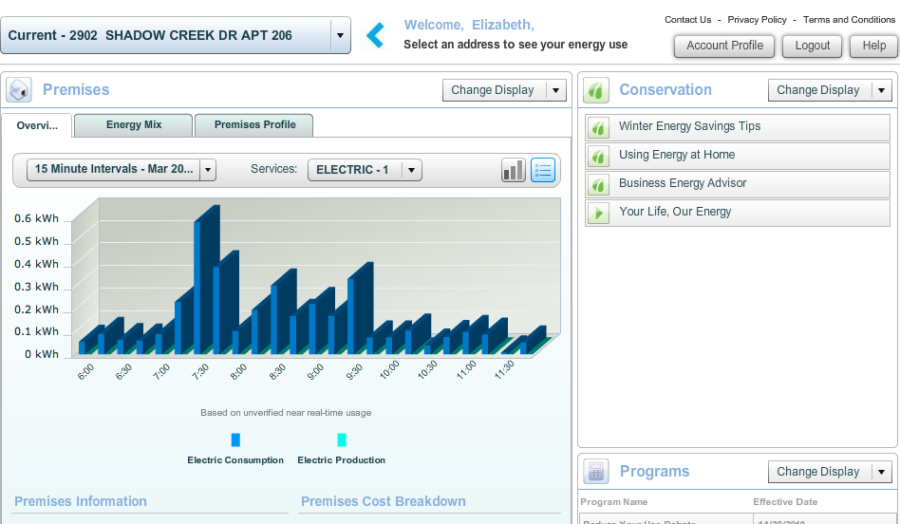
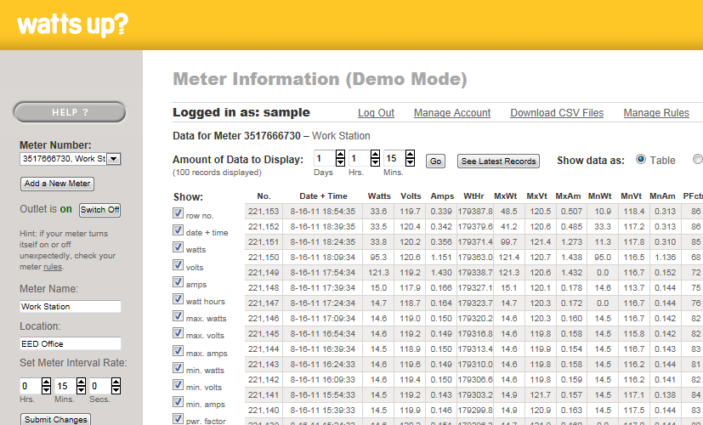
Smart-Meter and Smart-Plug Feedback
Feedback
How often did you look at the
smart-meter and smart-plug websites? (Post)
 | Percentages
Website | Never, once or twice | A few times | Often | Totals
Smart meter | 68 | 21 | 12 | 100
Smart plug | 70 | 22 | 9 | 101*
Smart-meter website
Smart-plug website
*Does not add to 100 due to rounding
Post-interview
(n = 141 households)

Slide 16
Charging Scenarios
Charging Behavior
Chi square = 20.326, p ≤ .000
(n = 92 households, modified sample)

Slide 17
Anomalous Cases (S/M)
Charging Behavior
17
9%
Standard/Managed/Managed (7 cases)
3 forgot how to program their plugs 2 thought they had TOU rates but didn’t 1 was being conscientious for the sake of the study (wanted to change) 1 changed to unmanaged when they wanted to charge during the day but went back to managed otherwise
Standard/Unmanaged/Managed (1 case)
1 changed to managed halfway through the study so their car wasn’t charging when their Christmas lights were on
Post-interview (n = 92 households)

Slide 18
Anomalous Cases (T/U)
Charging Behavior
18%
Time-of-Use/Unmanaged/Unmanaged (11 cases)
2 forgot how to program their plugs 4 self-managed charging behavior 3 experimented with managed, but decided it was not worth the hassle 2 realized it was cheaper to drive on electricity, even with TOU rates
Time-of-Use/Managed/Unmanaged (5 cases)
3 did not like set charging schedule; too inconvenient 1 eventually left unmanaged because they did not want to buy gas 1 changed to unmanaged on November 1 when they thought TOU rates were over (actually September 30 was end of summer on-peak rates)
Post-interview (n = 92 households)

Slide 19
Patterns of Change
Charging Behavior
Changed or experimented
S
T
U
n = 16
Stayed the same
S
T
U
n = 20
M
n = 40
M
n = 10

Slide 20
Charging Management Behaviors
Charging Behavior
22
18
14
11
9
9
3
Set for overnight hours (perm or temp)
Forgot about it/
too much trouble
Self-managed
Stayed managed to help the study
Set around TOU hours
(8 pm-2 pm) (perm or temp)
Set for unmanaged
(perm or temp)
Left programming as it was
Number of households
Post-interview (n = 86 households)

Slide 21
Electricity vs. Gasoline
Costs per Charge
Standard vehicle: 30 mpg; fuel cost - $3.75/gal.
PHV: Battery size (kWh): 5.2
Range (miles): 13
Gals. equivalent: 0.43
Electricity Cost $/kWh | Standard Tier 1 | Standard Tier 2 | TOU Summer On-peak | TOU Winter On-peak | TOU Off-peak
Cost per charge | $0.46 | $0.73 | $1.22 | $0.55 | $0.42
Electric equivalent $/gal. of gas | $1.07 | $1.68 | $2.82 | $1.26 | $0.98
Savings per gallon | $2.68 | $2.07 | $0.93 | $2.49 | $2.77
Source: Xcel Energy, Inc.

Slide 22
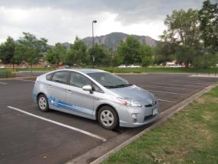
Part Two
Summary of vehicle and smart-plug data analysis
Driving patterns
Charging patterns
Comparisons between ending charging scenarios: managed and unmanaged households
Slides for Part Two were prepared by Dragan Maksimovic, Ph.D., Co-PI

Slide 23
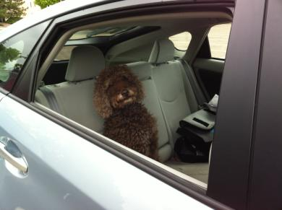
Analysis Overview
Data from 27 vehicles in 138 Boulder households
Smart plug data on vehicle electricity use
Around 12,000 vehicle trips, total of 91,000 miles
Total of around 27 MWh of electricity used for charging

Slide 24
An Example of Data Logged
1.8 miles trip
From vehicle data logger
5.2 miles trip
1.9 miles trip
Vehicle speed [km/h]
0.2 miles trip
2.7 kWh charging event
2.1 kWh charging event
From smart-plug data logger
Charging power [kW]
Battery EV state of charge (SOC) [%]
Combined vehicle and smart-plug data

Slide 25
Summary
 |  | Boulder average | US-wide average
Fuel economy [mpg] |  | 68 | 56
Trip distance [mile] |  | 7.5 | 11.1
Number of trips per day |  | 3.2 | 2.6
Number of charging events per day |  | 0.8 | 0.5
Charging electricity consumption per day [kWh] |  | 2.3 | 1.5
Driving in EV mode [%] |  | 42 | 27
Energy consumed [Wh/mile] | Fuel | 500 | 600
 | Electricity | 90 | 50
 | Total | 590 | 650

Slide 26
Distribution of Fuel Economy
Boulder Households Summary
Average for Boulder households: 68 mpg

Slide 27
Distribution of the average number of trips per day
Boulder Households: Driving Patterns
Driving Patterns
Average trip distance: 7.6 miles (12.2 km )
Average number of trips per day: 3.2
Distribution of the average trip distance

Slide 28
Fuel Economy vs. Trip Distance
Boulder Households: Driving Patterns
EV range
88% of trips are shorter than 13.2 miles (vehicle EV range)
On average fuel economy peaks at over 90 mpg for 2- to 5-mile trips
On longer trips, fuel economy converges to an average of 54.4 mpg

Slide 29
Energy Consumption Versus Trip Distance
Boulder Households: Driving Patterns
On short trips, up to about one third of energy consumed comes from electricity
Energy consumption lowest (about 500 Wh/mile) for 2-8 mile (3-12 km ) trips

Slide 30
Energy Consumption Versus Temperature
Boulder Households: Driving Patterns
Lowest overall energy consumption around 20 ºC (70 ºF)
Patterns observed are expected; extra energy used for heating or cooling

Slide 31
Distribution of the average number of charging events per day
Boulder Households: Charging Patterns
Average number of charging events per day: 0.8
Average charging electricity consumed per day: 2.3 kWh
Distribution of the average charging electricity consumption per day

Slide 32
Impact of Distance between Charging on Fuel Economy
Boulder Households: Charging Patterns
EV range
distance between charging (mile)
Distance traveled between charging events is less than 13.2 miles (EV range) in almost 57% of the cases

Slide 33
Parking and Charging Locations
Boulder Households: Charging Patterns
Finishing a trip
42%
58%
At home
Outside home
25%
17%
2%
56%
Charge
No charge
Charge
No charge
Real-life limitations
Lack of charging infrastructure, and other real-life limitations
20%
4%
Charge at smart plug
Charge at ordinary plugs
27% of trips followed by a charging event

Slide 34
Boulder Households: Charging Patterns
At home
About 60% of trips ending at home followed by charging
charging
Away from home
About 3% of trips ending away from home followed by charging
charging
Overall
charging
Overall, 27% of trips followed by charging

Slide 35
When does charging occur?
Boulder Households Charging Patterns: Managed vs. Unmanaged
For managed households, probability of charging events peaks from 8 pm to 10 pm

Slide 36
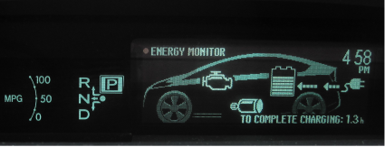
Summary of Data Logger and
Smart-Plug Data Analysis
Summary Vehicle & Smart-Plug Analysis
Overall fuel economy depends primarily on
  Trip length
  Frequency of charging
In Boulder, majority (around 88%) of trips are
within the vehicle EV range
Electricity displaces up to about 30% of total of
energy consumed per mile
In Boulder, about 27% of trips
are followed by a charging event
  Many different real-life reasons
  Lack of charging infrastructure

Slide 37
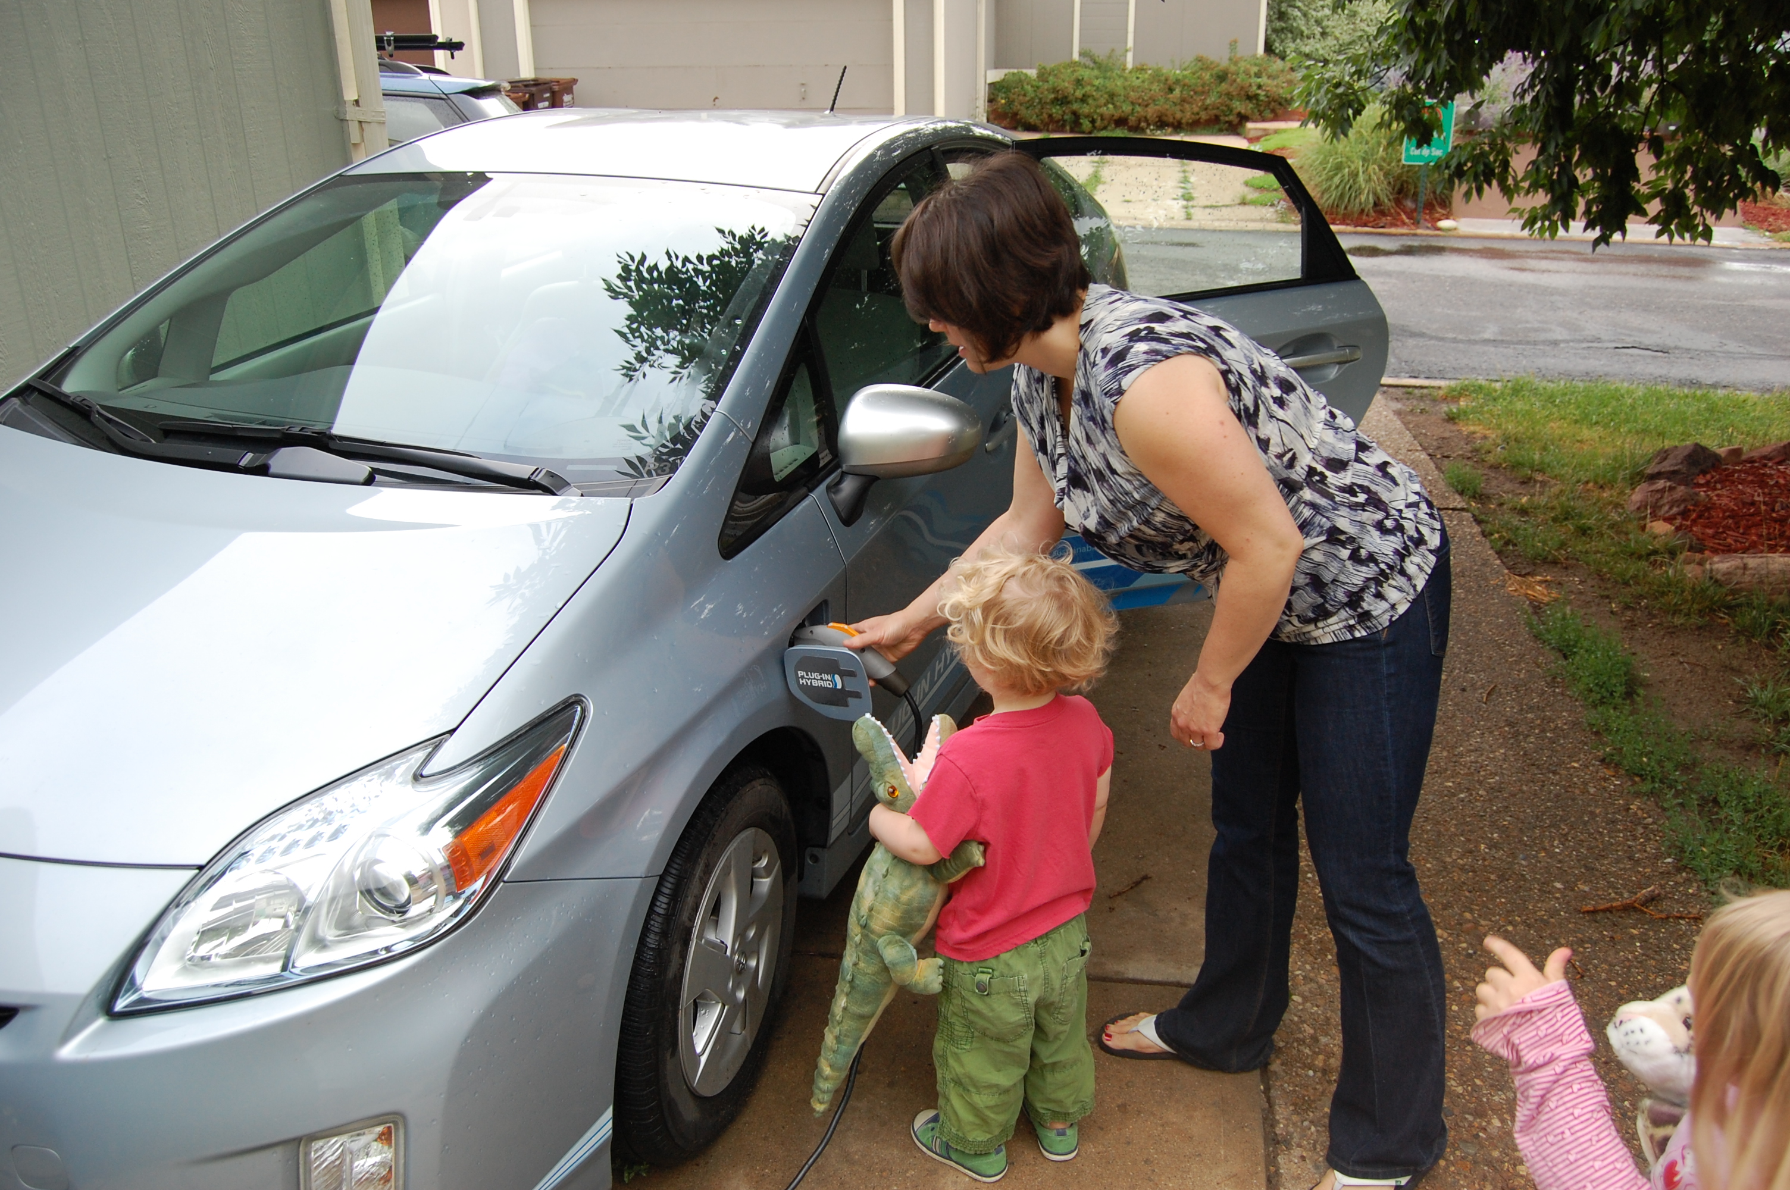
Part Three
Barbara C. Farhar, Ph.D.
Ongoing analysis
Preliminary conclusions

Slide 38
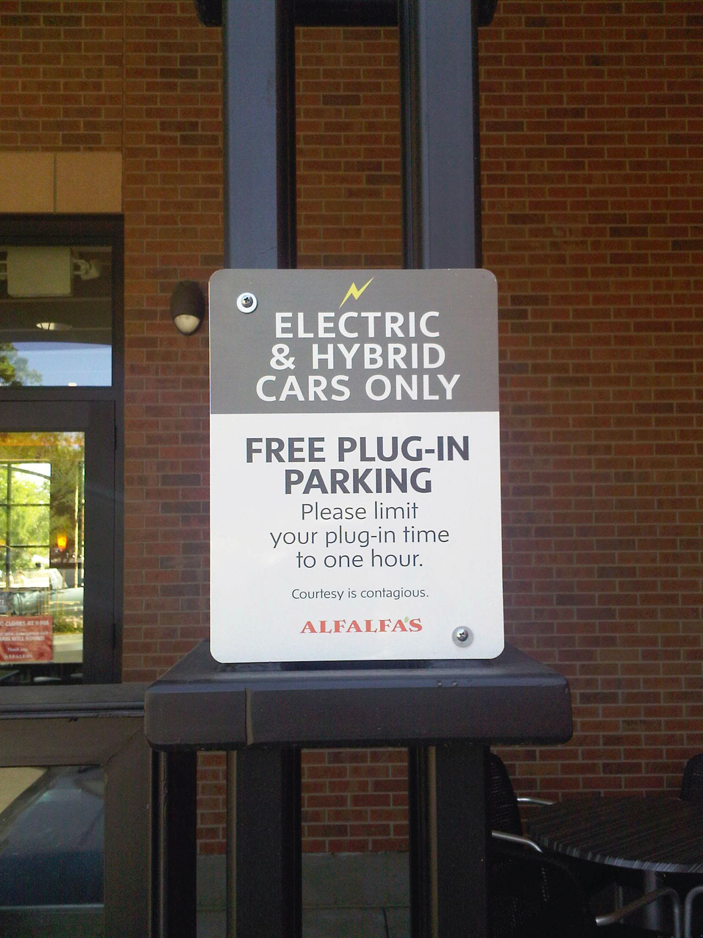
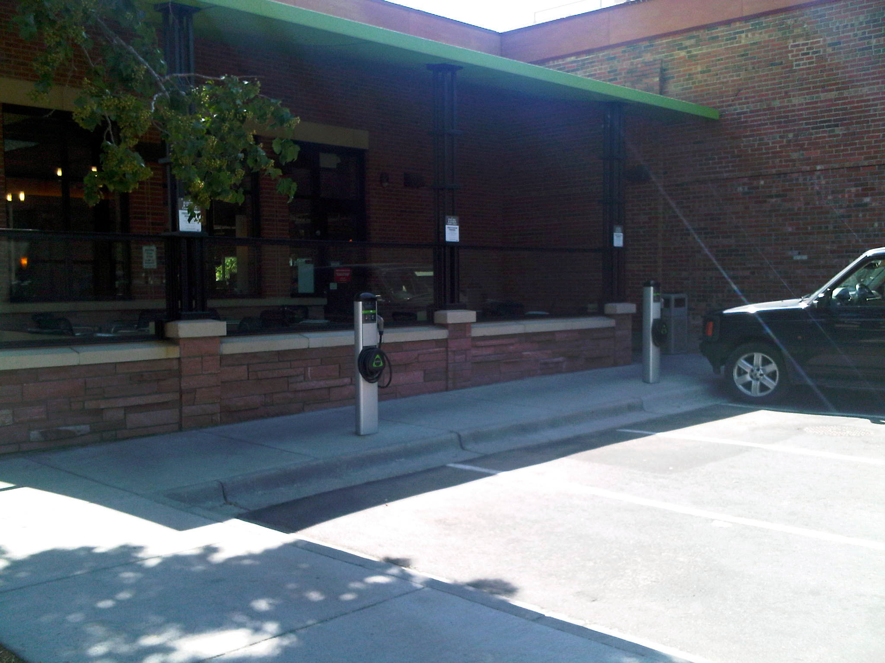
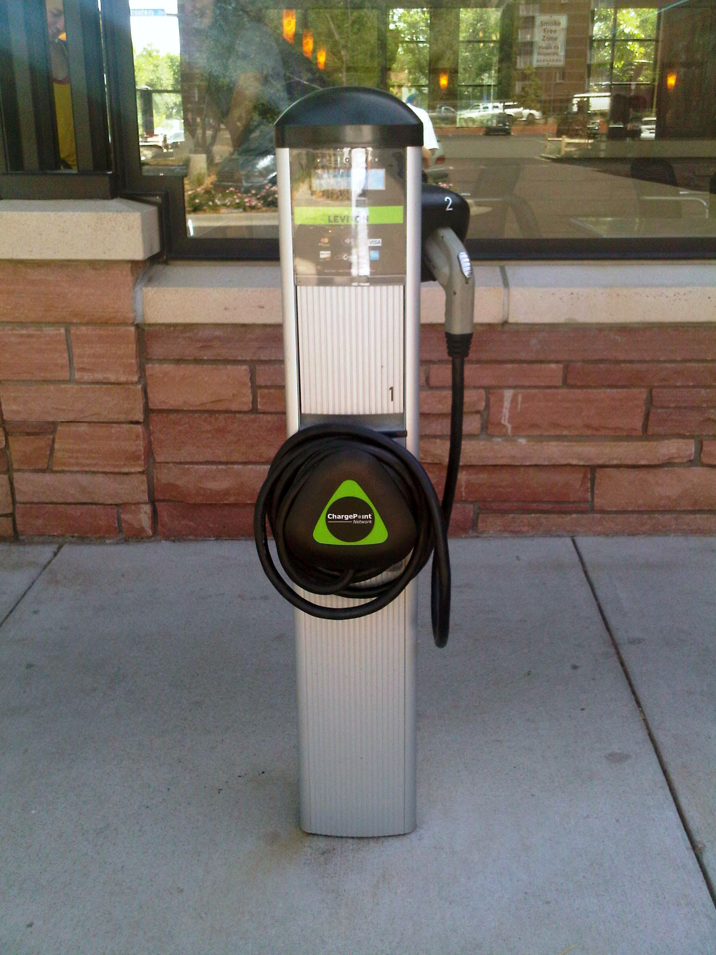
Use of Charging Stations
Ongoing Analysis
Alfalfa’s Market
Arapahoe Ave

Slide 39
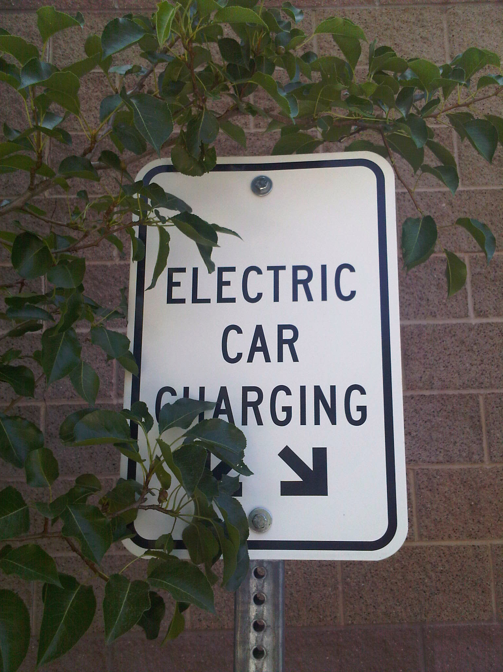
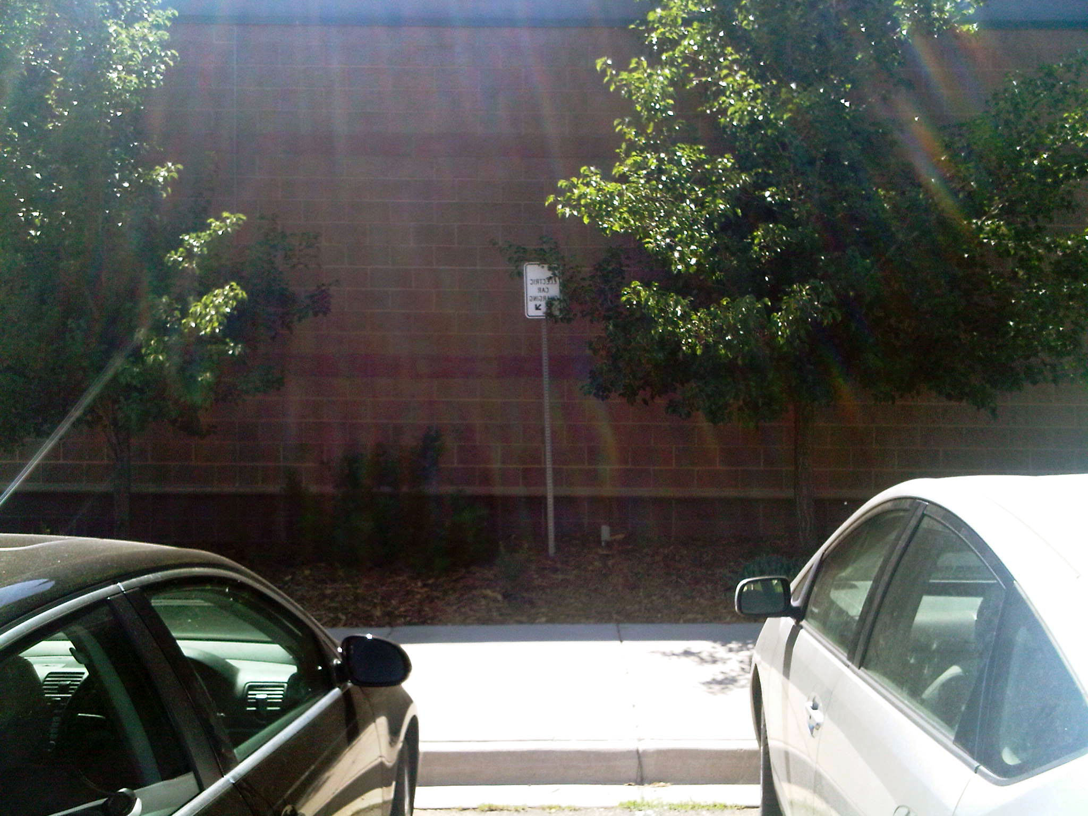
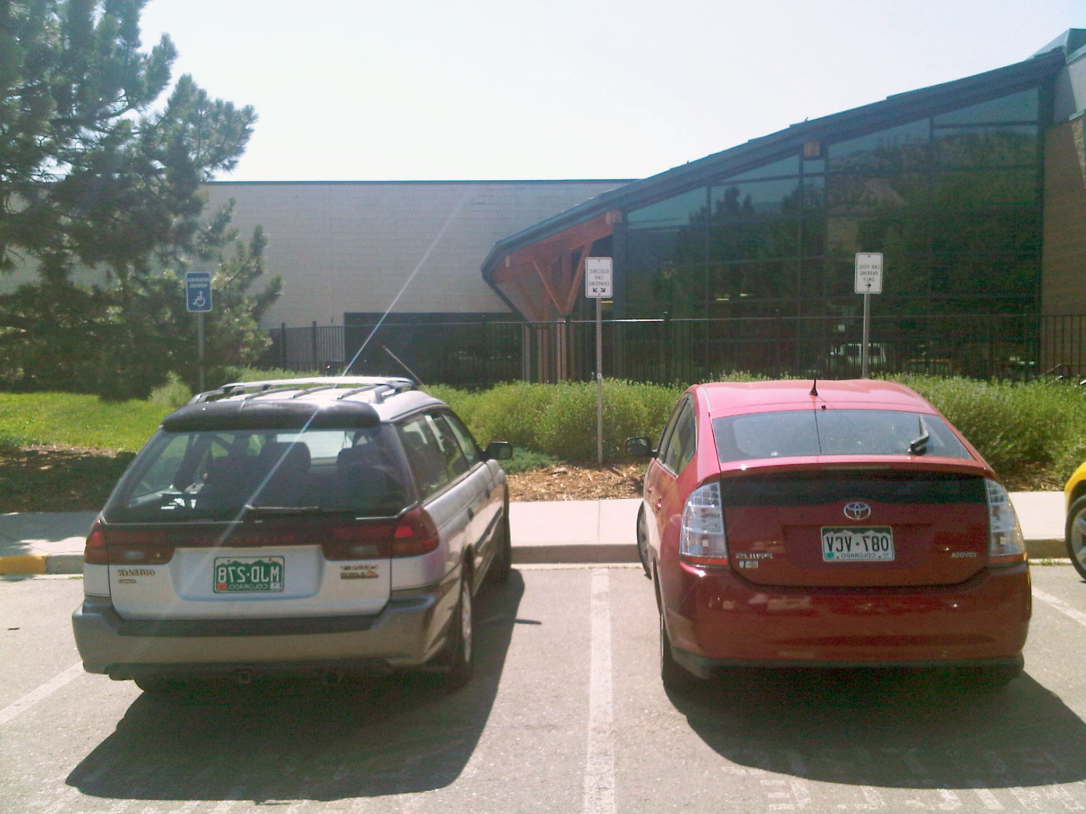
Use of Charging Stations
Ongoing Analysis
North Boulder Rec Center

Slide 40
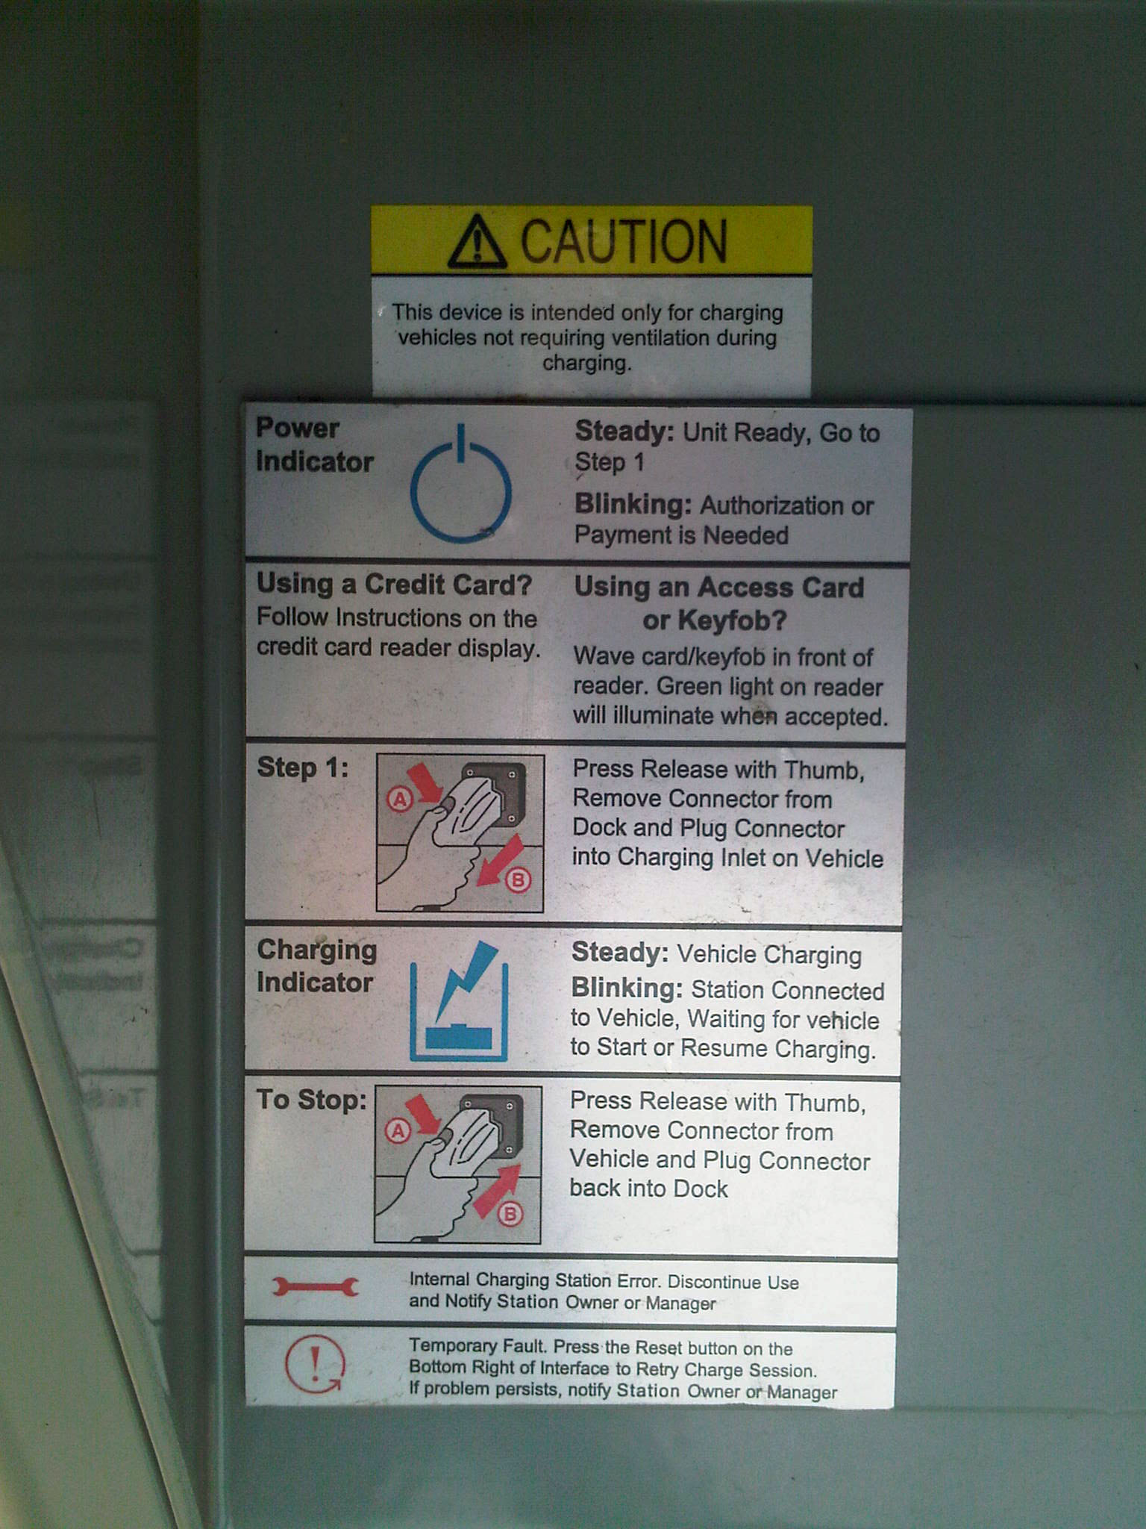
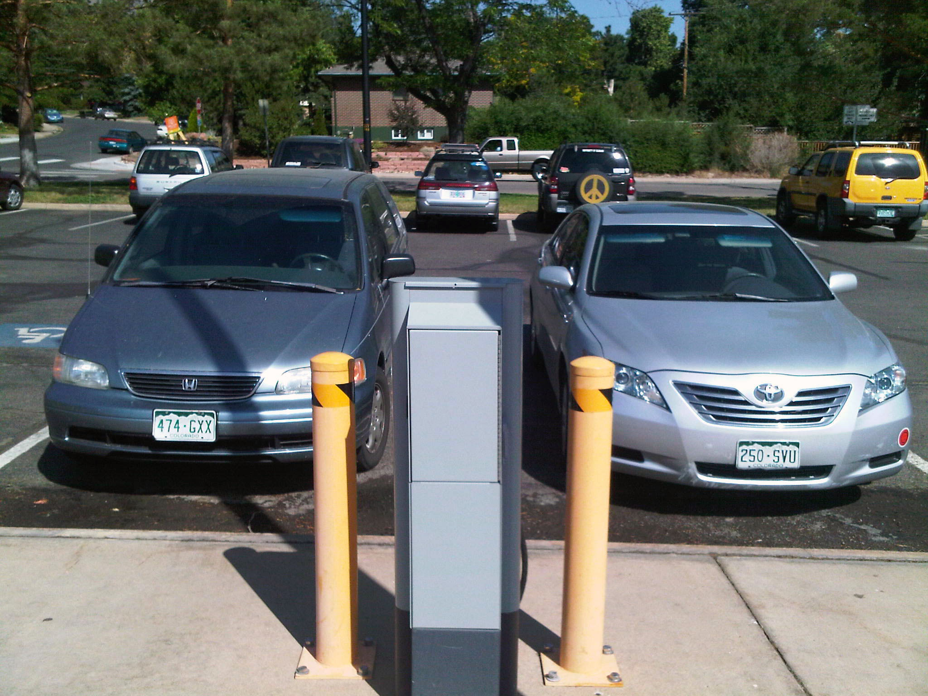
Use of Charging Stations
Ongoing Analysis
South Boulder Rec Center

Slide 41
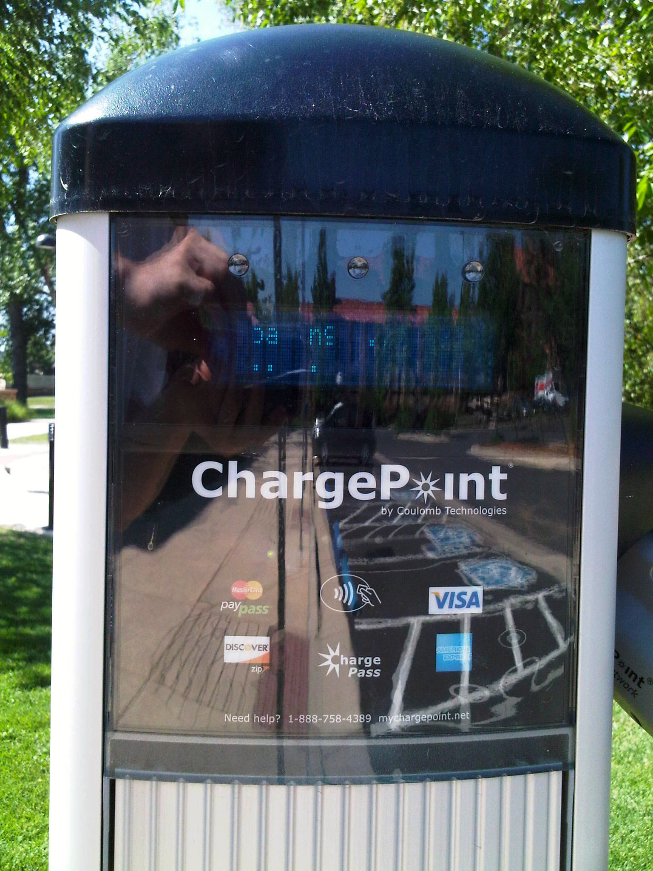
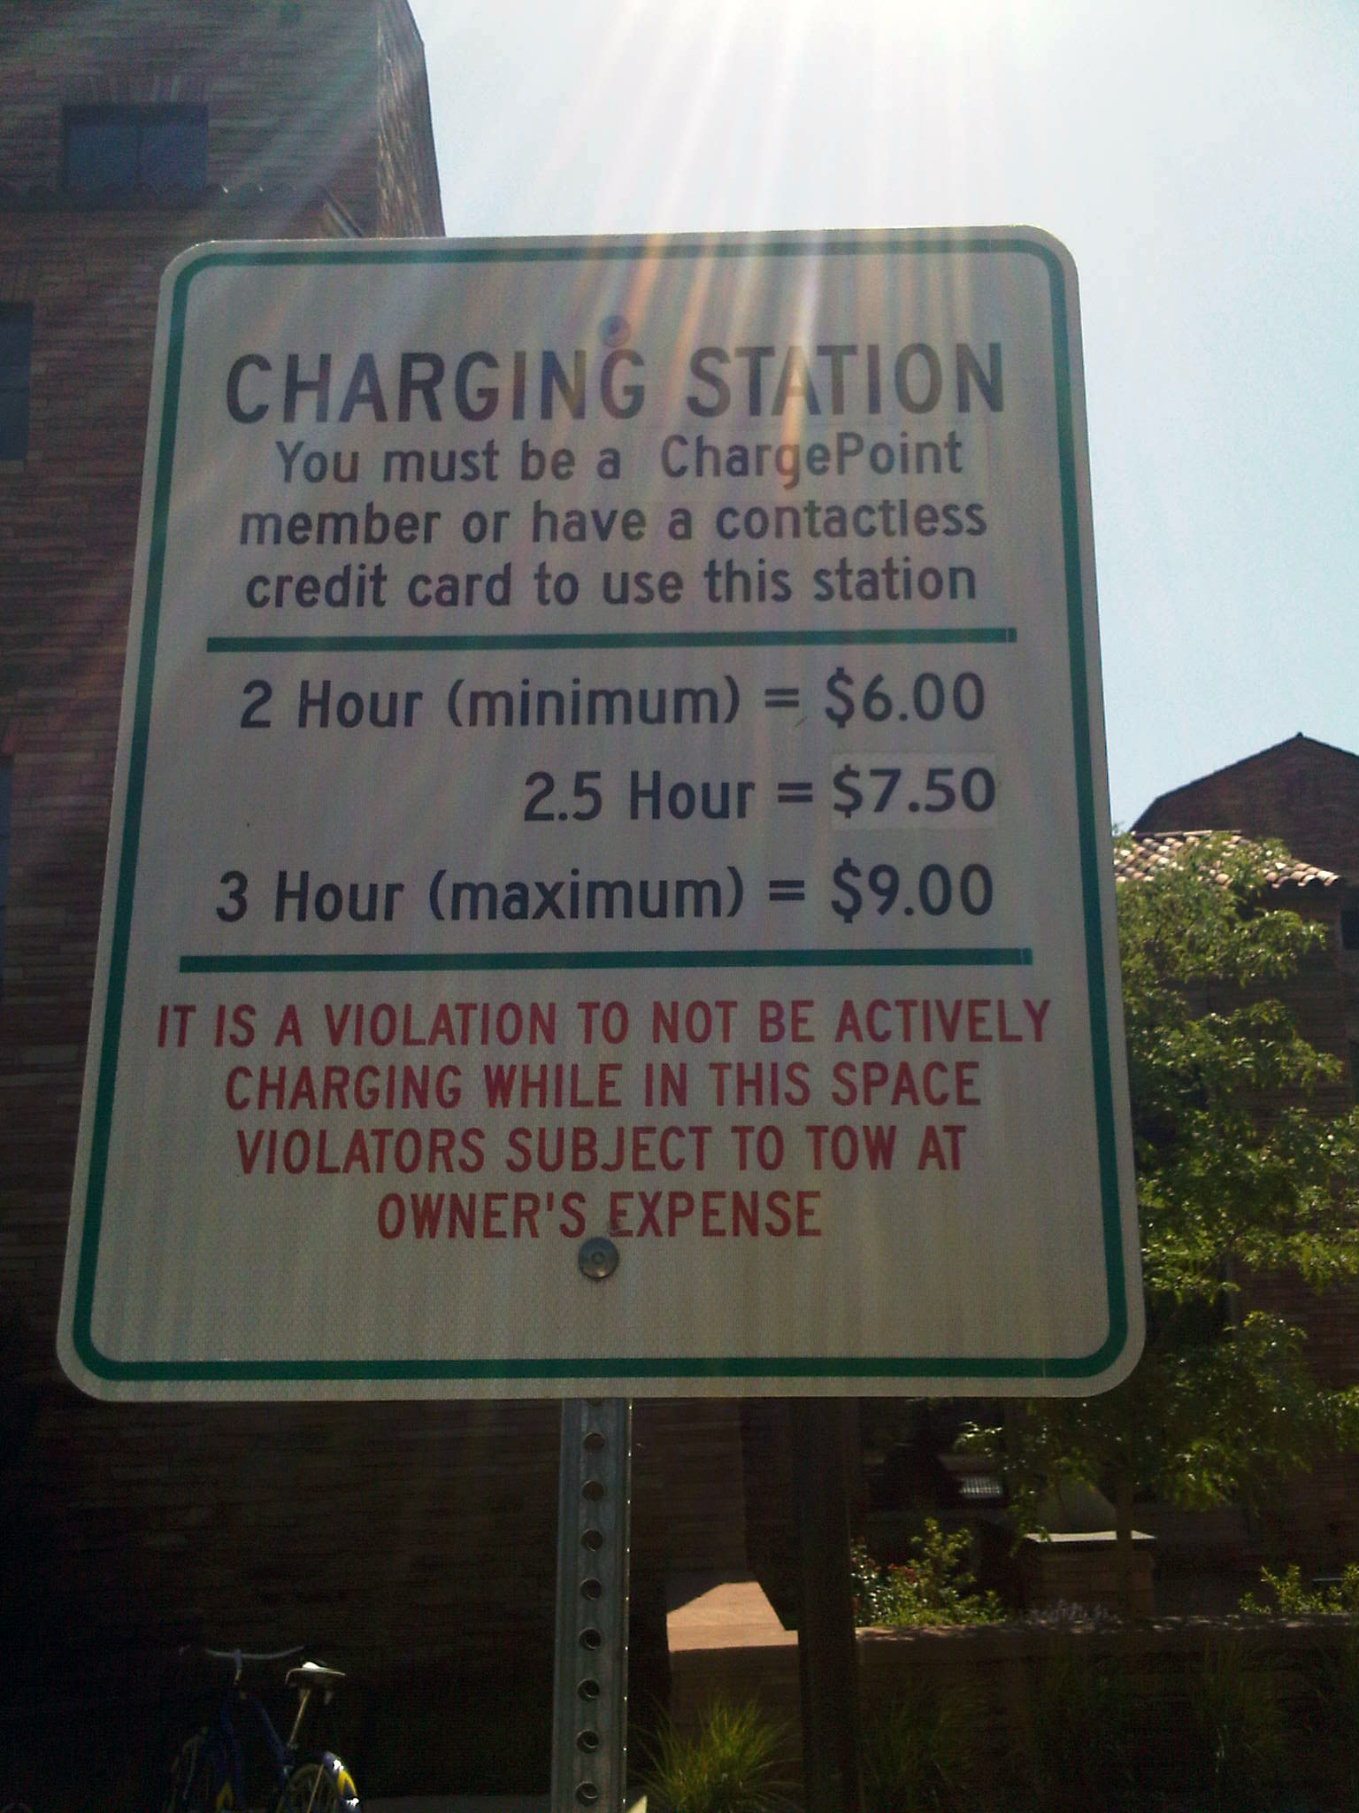
Use of Charging Stations
Ongoing Analysis
Wolf Law Building

Slide 42
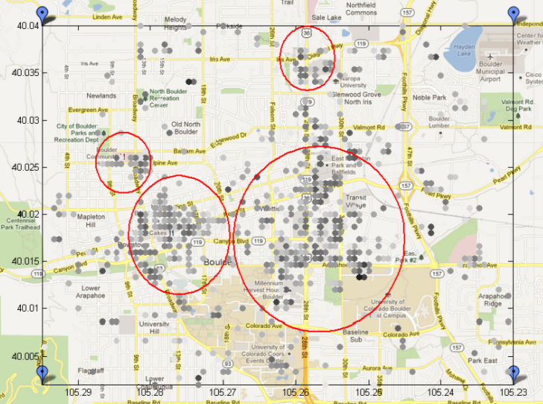
Ideal Electricity Demand Potentials for Hypothetical Public Charging Stations in Boulder
Ongoing Analysis: Opportunities for Charging Infrastructure
Ideal potential electricity demand computed based on the time per day a vehicle spends parked on average in the area shown
0.12 kWh per day per vehicle
0.09 kWh per day per vehicle
B
A
D
A North Broadway shopping center
B 28th & Diagonal
C Multiple parking lots around 29th St. Mall
D Multiple downtown parking lots
0.41 kWh per day per vehicle
C
1.13 kWh per day per vehicle

Slide 43
Satisfaction with the PHV
(Interview and Data Logger Data)
Ongoing Analysis
Is higher when the starting and ending SOC is higher
Is higher when the cars used more electricity each day
Is higher when the distance between charges is shorter
How did you like driving the PHV? | %
Loved it | 57
Liked it | 37
Did not like it | 6
Total n | 142
Correlations significant at p ≤ 0.01

Slide 44
Satisfaction with EV Range
(Interview and Data Logger Data)
Ongoing Analysis
Is higher at lower household average speeds
Is higher when average household trips are shorter
Is higher when more driving is in EV mode
Is lower as kWh/km goes up
Satisfaction with EV Range | %
No | 76
Yes | 24
Total n | 135
Correlations significant at p ≤ 0.01

Slide 45
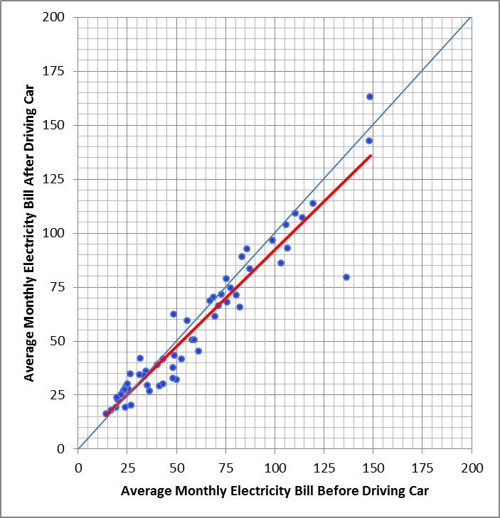
Correlation of Average Monthly Electricity Costs, 4 Months after the Field Test and the Same 4 Months One Year Before
Ongoing Analysis

Slide 46
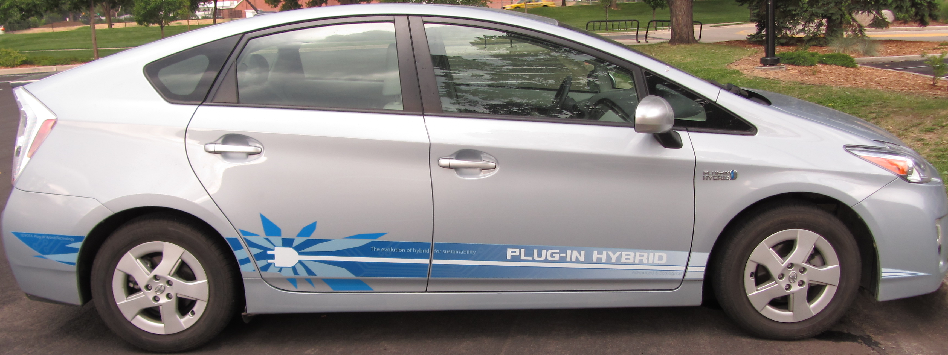
Off-site Charging
TOU’s used significantly more kWh’s overall . . .
Ongoing Analysis
At home
“Trips”
Away from home
At home, TOU and standard households used essentially the same number of kWh’s
Std
Away from home, TOU households used significantly more kWh’s and charged longer
Std
TOU
TOU households drove more miles and took more “trips,” but durations of trips and distances travelled were essentially the same
TOU
TOU
kWh’s
kWh’s
Std

Slide 47
Preliminary Conclusions
Preliminary Conclusions
By and large, households actively managed their charging
We discovered seven discrete categories* of charging- management behavior
Most households did not use online feedback to manage their vehicle charging
*Set smart-plug programming for unmanaged, set around TOU hours, set for overnight, left programming as it was, forgot about it, self-managed, stayed managed

Slide 48
Preliminary Conclusions, cont’d.
Preliminary Conclusions
Households tended to find managed charging inconvenient
To use managed charging, TOU households prefer a simple “set-it-and-forget-it” approach with easy override
Electricity pricing drove charging-management behavior
Time-cost/convenience were also important

Slide 49

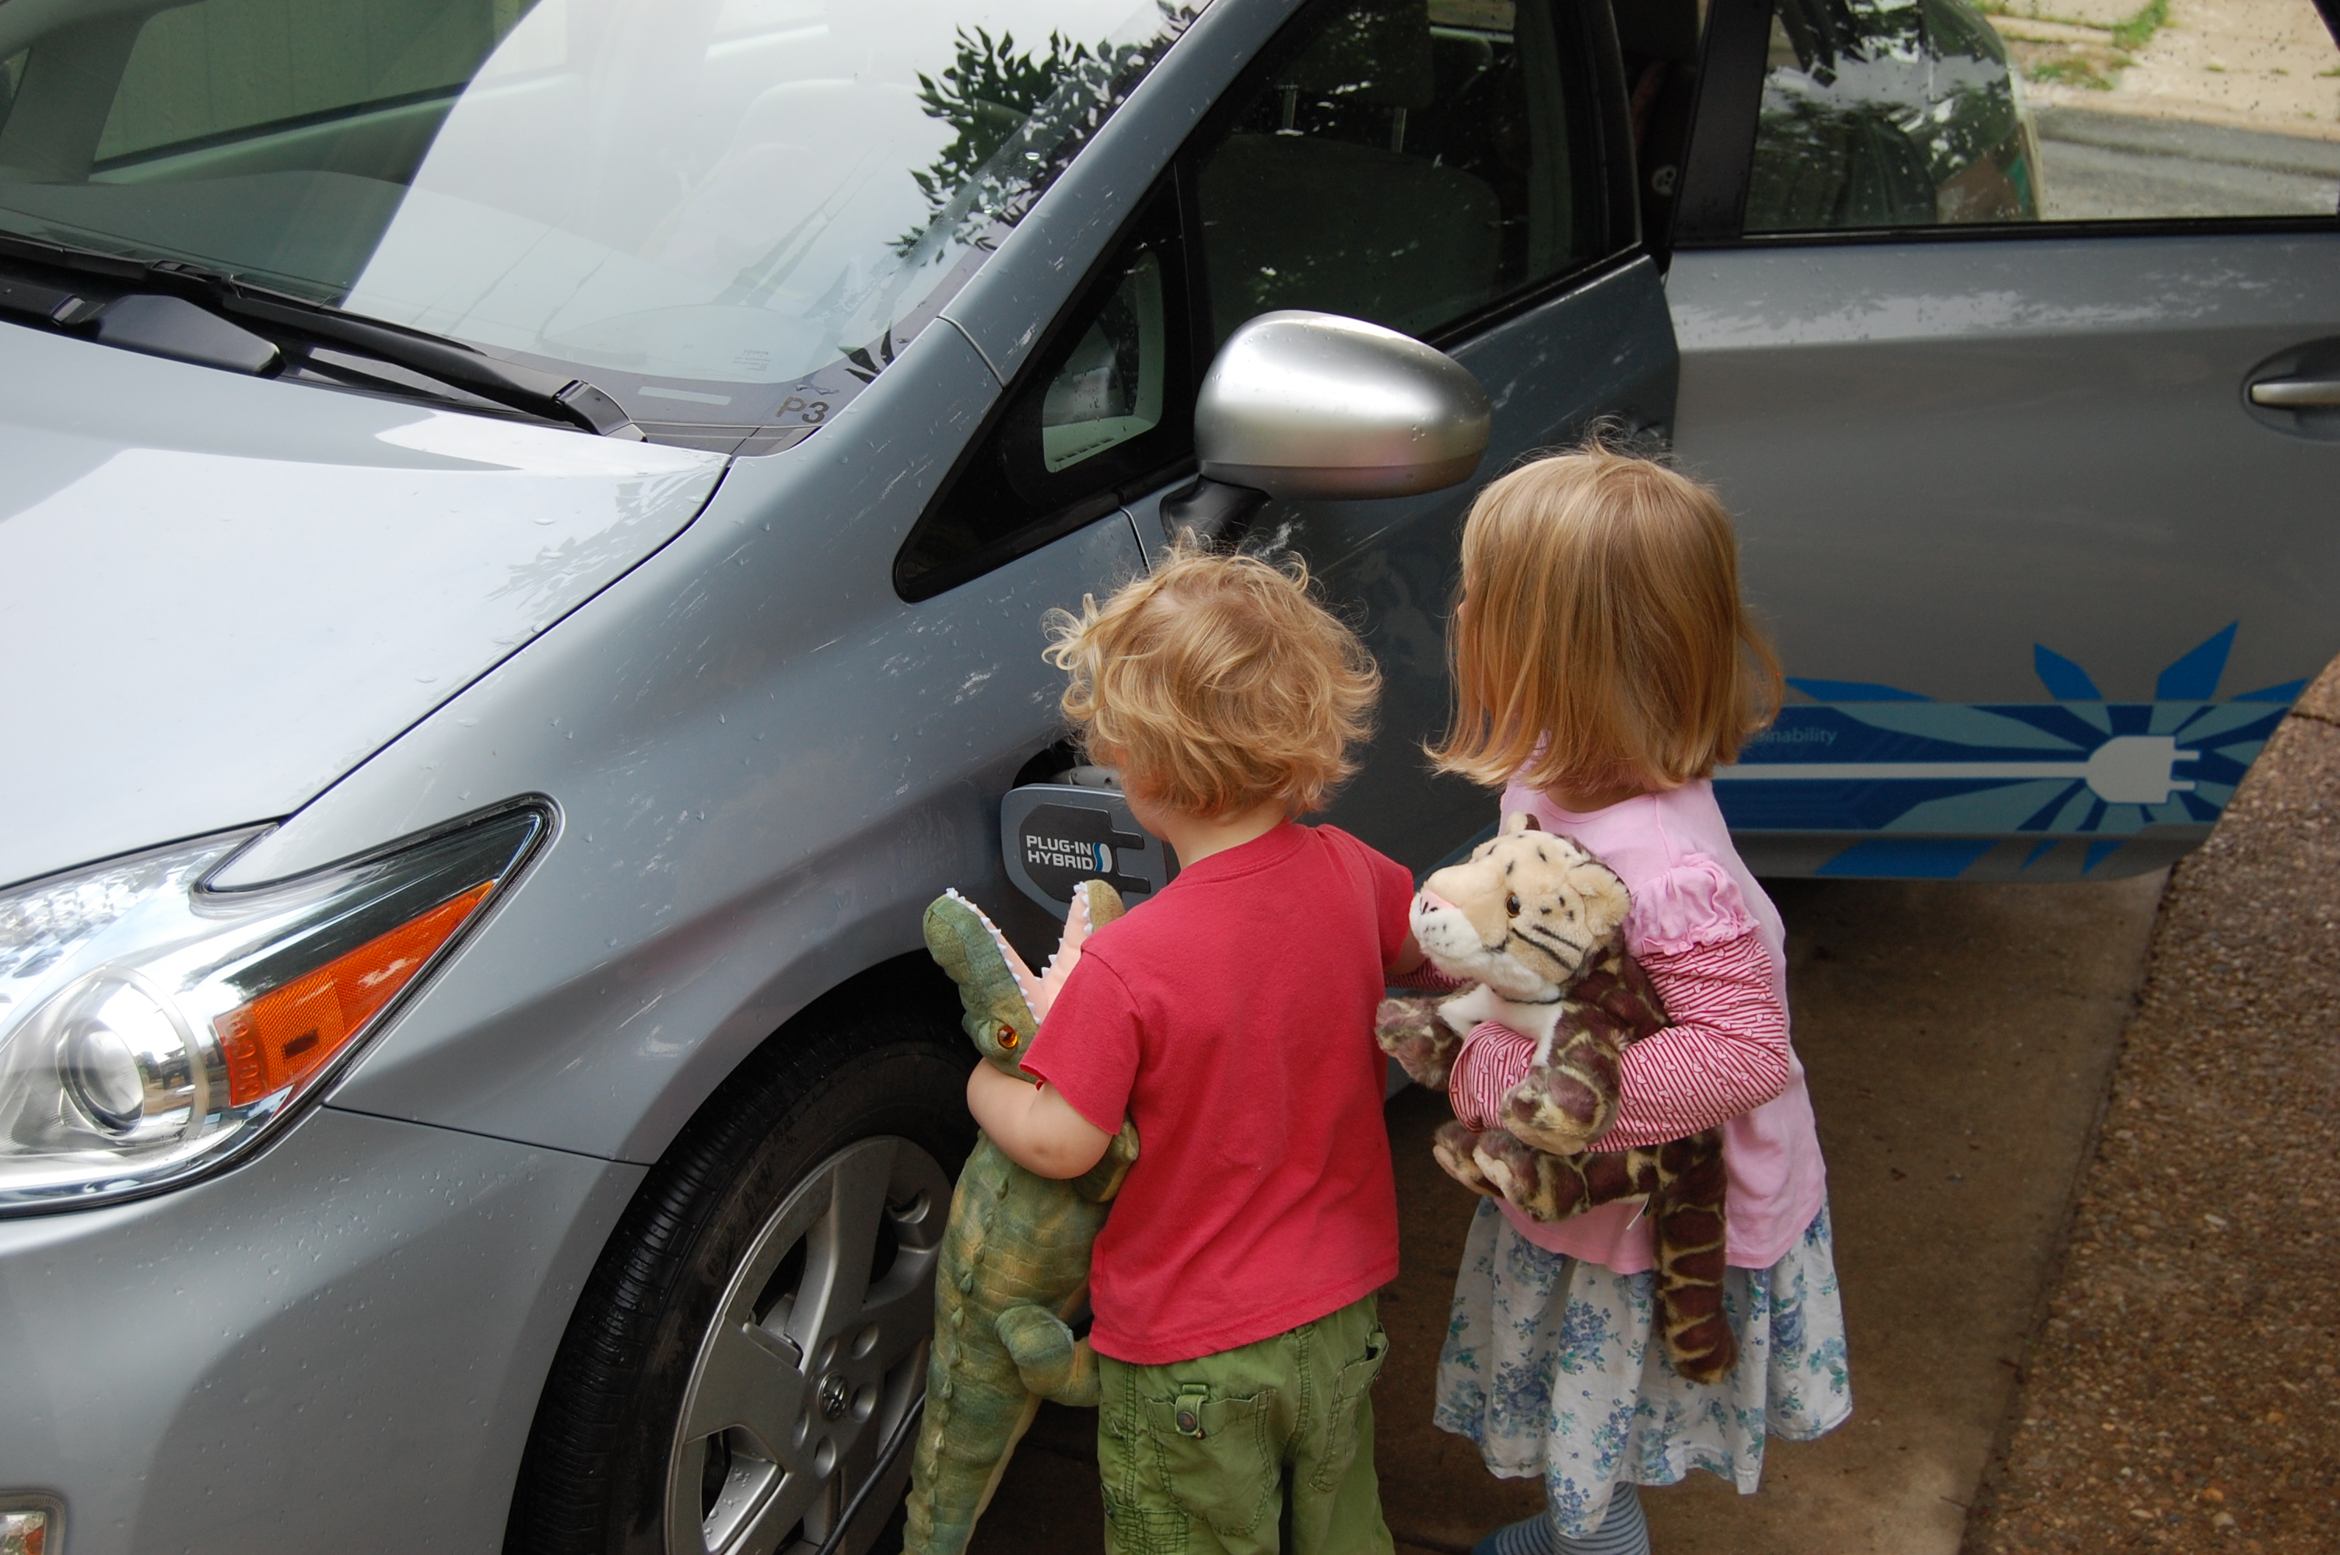
Thank you! Any questions?
Barbara C. Farhar, Ph.D.
Principal Investigator
303-492-5452
barbara.farhar@colorado.edu

